Slide 1

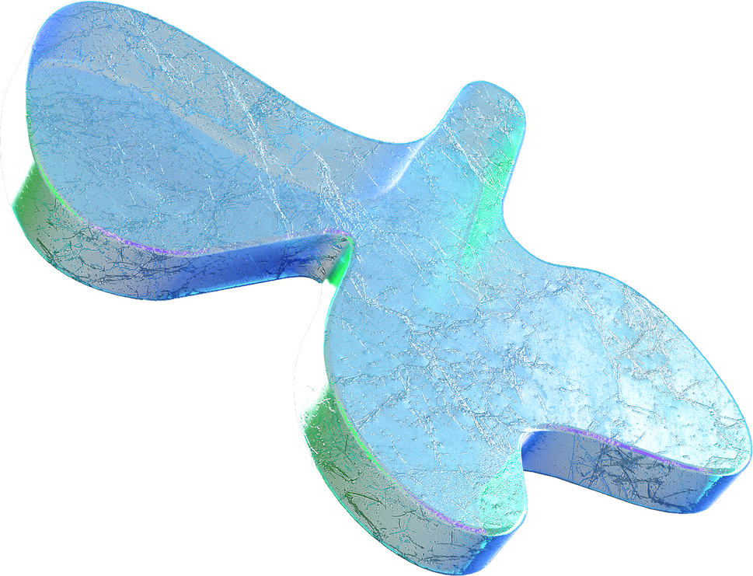
BITI 3533 : AI Project Management
Aircraft Predictive Maintenance
Take a precautionary step before the breakdown happens

Slide 2



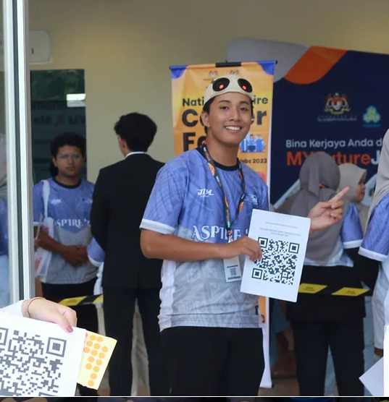

Project Staff
Muhammad Zawawi
(Project Manager)
Adam Airil
(Secretary)
Muhammad Hakimudeen
(Vice Project Manager)
Abdul Rahman Auf
(Treasurer)

Slide 3
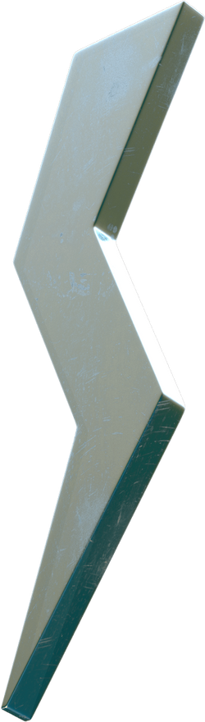
1) Background & Case Study (Intro)
2) Detail about software used
3) Detail on AI Project Management
4) Flow, Algorithm & Problem Solving
5) Project Implementation & Output
6) Conclusion
Content
What you need to know

Slide 4
1)Background & Case Study
2)Detail about Software Used
Muhammad Hakimudeen
(Vice Project Manager)

Slide 5
Background & Case Study
Hybrid prediction models, fusing various machine learning algorithms like genetic algorithms and neural networks, bring precision and reliability to transportation maintenance forecasts. They offer cost reduction and enhanced safety through early issue detection.
Motivated by the surge in mid-aircraft crashes, we initiated a project employing recurrent neural networks (RNNs) for predictive maintenance. Our focus is on predicting aircraft engines' remaining useful lives (RUL), providing airlines with a proactive tool for enhanced safety and significant cost savings. The hybrid design of our models, combining single multi-layer perceptron neural networks with radial basis functions, offers nuanced insights for maintenance planning, marking a transformative step in aviation efficiency.

Slide 6
Detail about software used
core tools : matlab
Deep learning toolbox
Neural network toolbox
matlab graph and chart tool
pycharm

Slide 7
3) Detail on AI Project Management
Adam Airil
(Secretary)

Slide 8
5-Phase Project Flow
Initiating
Planning
Executing
Monitoring
Closing
Identify willing stakeholders.
Develop project charter.
Plan project management.
Define scope management.
Collect project requirements.
Create work breakdown structure.
Plan schedule management.
Plan project costs.
Plan risk management.
Acquire, develop, manage team.
Direct and manage work.
Perform quality assurance.
Manage team communication.
Manage stakeholder engagement.
Perform change control.
Validate project scope.
Control project schedule.
Control project costs.
Check prototype quality.
Control project risks.
Control stakeholder engagement.
Properly close project phases.
Deploy or launch product.

Slide 9
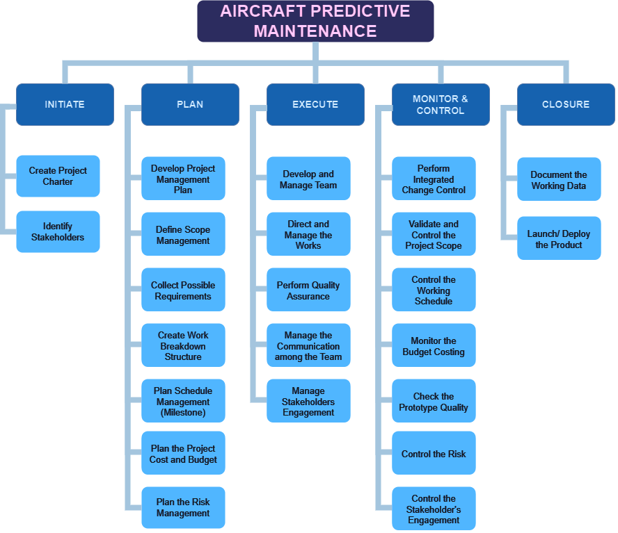
Work Breakdown Structure

Slide 10
Project Insight
Scope
Time
Cost
Quality
Integration
Create NN-based APMS predicting aircraft failures detailing functionalities.
Identify limitations.
Decide maintenance scheduling tools.
Create detailed project schedule with milestones.
Considering dependencies and risks.
Using efficient time management
Create comprehensive budget detailing project expenses.
Monitor, save costs without quality loss.
Optimize resources.
Inform stakeholders regularly.
Establish APMS quality standards, KPIs.
Thorough testing for functionality, accuracy.
Foster improvement culture.
Address issues promptly.
Ensure holistic project integration.
Plan workflows.
Coordinate tasks
Manage interfaces for seamless Collaboration.
Ensure project success.
Human R.
Comm.
Risk
Procurement
Stakeholder
Recruit skilled personnel.
Encourage collaboration.
Offer training.
Address individual needs for motivation.
Establish clear, diverse communication channels.
Ensure regular updates.
Apply transparency.
Adaptability to various communication styles/tools.
Identify project risks.
Assess impact.
Create plans.
Monitor continuously communicate strategies to stakeholders for adaptation.
Select vendors.
Create contracts.
Maintain ethical procurement for project resource acquisition and management.
Engage the stakeholders.
Understand needs.
Involve in decisions.
Manage expectations.

Slide 11

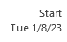
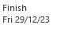
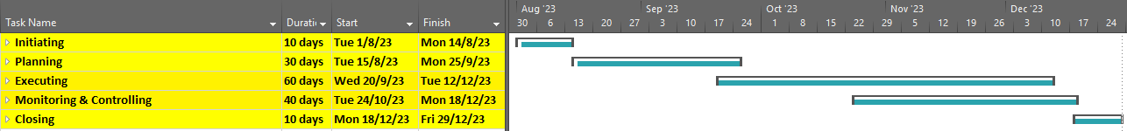
Gantt Chart
Overview
5-month project

Slide 12
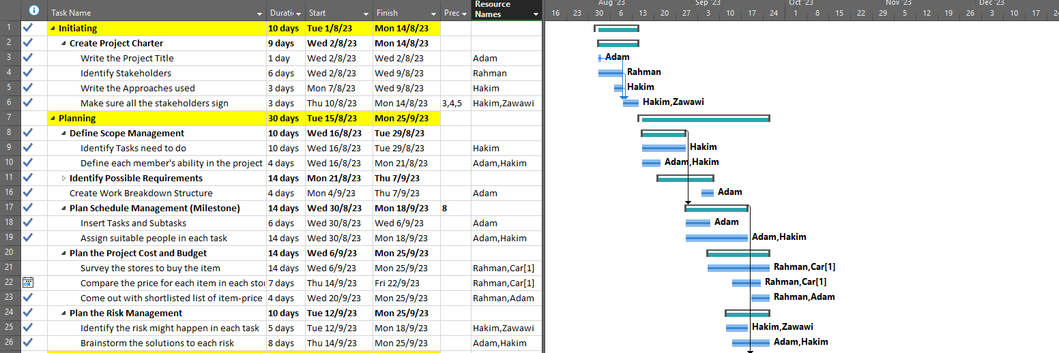
Gantt Chart
Initiating & Planning

Slide 13
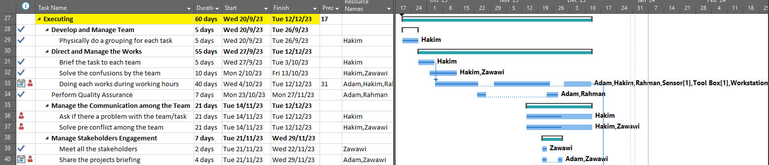
Gantt Chart
Executing
Full list of resources:
Worker: Adam, Zawawi, Hakim, Rahman
Others: Sensor, Toolbox, Workstation, Car

Slide 14
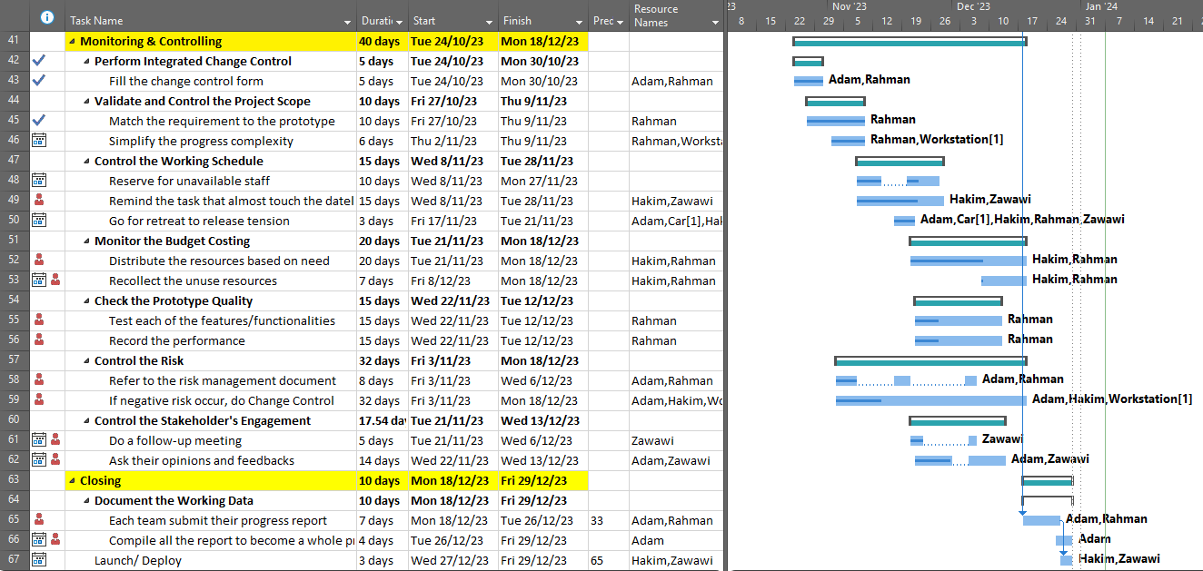
Gantt Chart
Monitoring & Closing

Slide 15
4) Flow, Algorithm & Problem Solving
Muhammad Zawawi
(Project Manager)

Slide 16
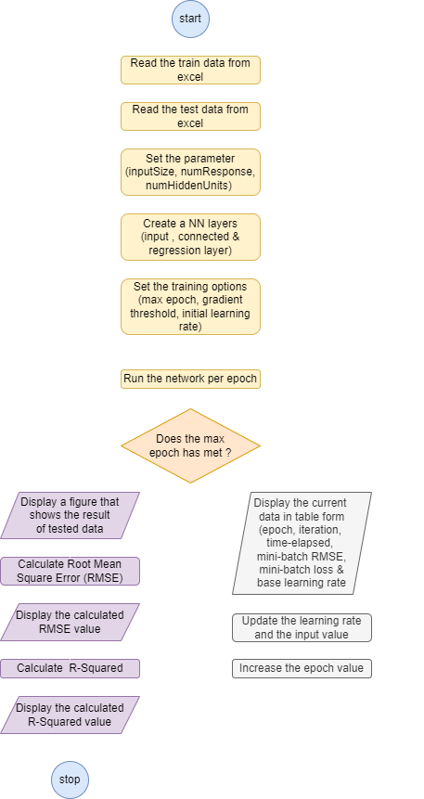
Flow

Slide 17
Algorithm
Long Short Term Memory (LSTM)
Used in the learning & analysis process for predictive maintenance of aircraft engine
Data are presented in sequence, and LSTM learnt to predict the next element in sequence.
Data used are Engine ID, Engine setting and Engine sensors data.
Used to estimate the remaining usable life (RUL)
Avoid unanticipated breakdown & increase safety

Slide 18
Problem-solving
1) Forecast RUL of aircraft engine
Identify components nearing the end of their life
Schedule interventions before components fail
Minimising unnecessary replacements & reducing maintenance costs
Improved safety and preventing potential accidents
Minimising downtime and maximising the operational efficiency of aircraft fleets
2) Continuous improvement of the industry
Establish a feedback loop with maintenance teams
Help the model adapt to evolving patterns
Ensuring that the system remains effective over time

Slide 19
5) Project Implementation & Output
6) Conclusion
Abdul Rahman Auf
(Treasurer)

Slide 20
Project Implementation & Output
Data collection and preprocessing
feature selection
machine learning algorithms
model training and evaluation
integration with aircraft systems
real-time monitoring

Slide 21
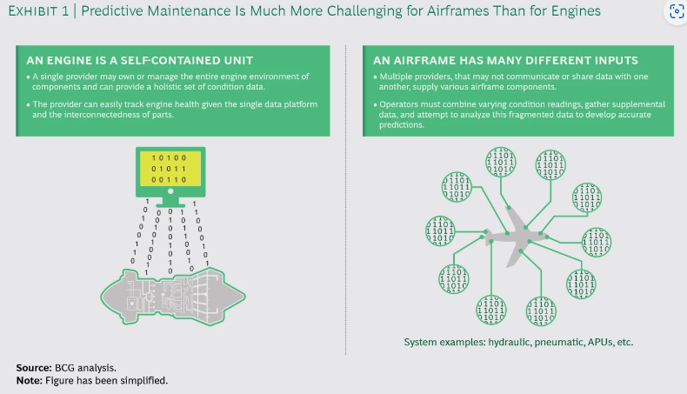
Project Implementation & Output

Slide 22
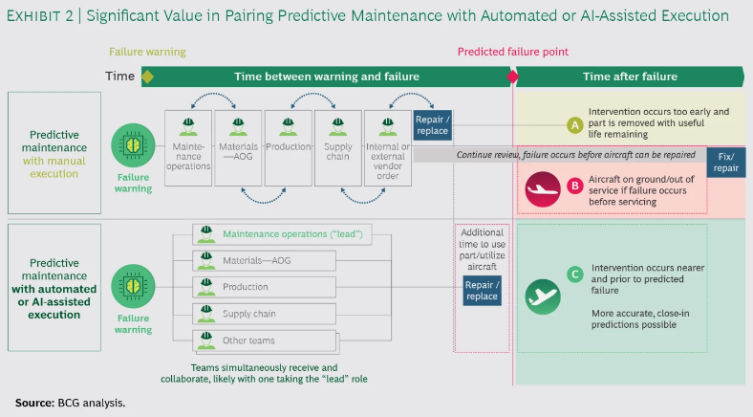
Project Implementation & Output

Slide 23
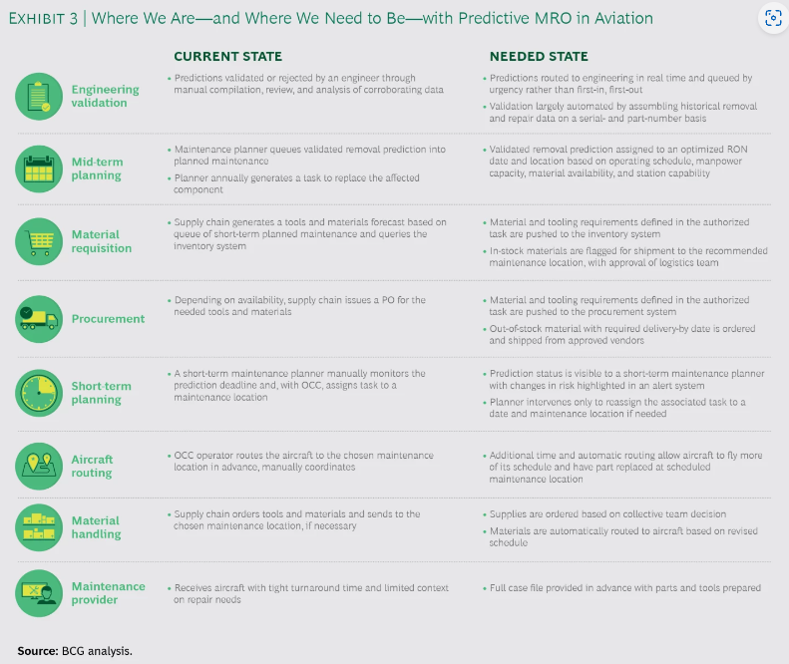
Project Implementation & Output

Slide 24
Conclusion
Benefits
By using the LSTM technique, the problems in aircraft predictive maintenance can be solved efficiently.
It can be used to forecast the remaining usable life (RUL) of aircraft engines which is it can :
help engineers to schedule maintenance before the machine fails.
help to reduce costs which engineers can identify components that are nearing the end of their life.
help to improve safety by preventing accidents. The engineers can identify machines that are at risk of failure.

Slide 25
Thank You

